Slide 1
From specification to prototype
Atardecer Bachata Festival · Valencia · 25–27 June 2027
Since Seminar 2
Main decisions
Try it
Teacher feedback applied: a simulated sign-up and login in the IA and scenarios
A clickable HTML prototype: 9 screens, mobile first, desktop layout
A design kit: palette, fonts and an image plan
Prototype stays mid-fidelity, grayscale
Look for the build: palette Golden Hour, Fraunces and Source Sans 3
12 illustrated avatars for 56 performers
Live on any computer: faiazyen.github.io/web-design-project/prototype/
Or double-click prototype/index.html
The Prototype guide in the footer walks through both scenarios
Notes:
PRESENTER: Faiaz (about 50 seconds).
Say: since Seminar 2 we applied the teacher's feedback (simulated login in the IA and scenarios), built a clickable HTML prototype that opens by double-click, and prepared the visual design for the build. Main decisions: the prototype stays mid-fidelity grayscale, the Golden Hour palette and two free fonts are for the real build, and performers without their own photo get illustrated avatars.

Slide 2
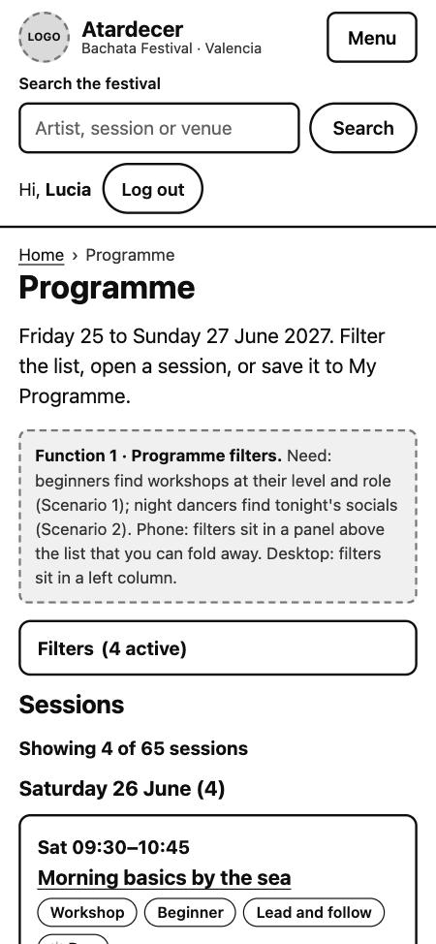
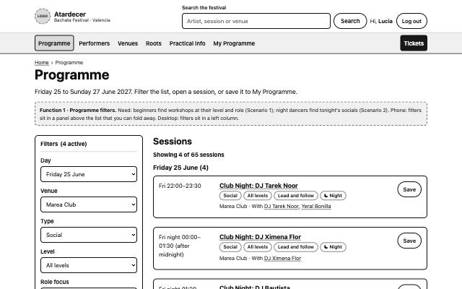
The HTML prototype: 4 functions for 4 user needs
1 Programme filters
Beginners find workshops at their level. Night dancers find tonight's socials.
2 Search
A returning visitor finds one artist by name and sees every session.
Phone first (left), desktop layout (right): filters move into a side column.
3 My Programme
A personal schedule with clash warnings and a calendar file.
Screens: Home, Programme, Session, Performers, Performer, Venues, Search, My Programme, Log in / Sign up.
4 Simulated login
The personal programme belongs to a person and is kept when they come back.
Notes:
PRESENTER: Oscar (about 60 seconds).
Say: the prototype is plain HTML, CSS and JavaScript. It is live online at a free address, so the teacher can open it on any computer, and it also opens by double-click. It is mobile first, with a desktop layout from 900 px. Four functions, each tied to a user need: filters, search, My Programme with clash warnings, and the simulated login the teacher asked for. Each is more than a menu: it changes what the visitor sees or keeps something for them.

Slide 3
Visual design for the build: Golden Hour
Day (Sea)
Background
#FFF7EC
Surface
#FFFFFF
Text
#1B2A41
Primary
#C93A22
Sea
#0B6E77
Highlight
#F2A33A
Muted
#4B5563
Night (Club)
Background
#0D1B2A
Surface
#14283C
Text
#FDF3E7
Primary
#FF7B5C
Sea
#57C7CE
Highlight
#F5B04C
Muted
#B8C4D0
Accessible by design
Contrast was calculated: text 13.6:1 by day and 15.9:1 at night, buttons 5.1:1 and 6.8:1. Meaning never depends on colour alone.
Type
Fraunces for headings and Source Sans 3 for text. Both free, saved on the site so it works offline.
Images
AI-generated, no real people: Day and Night hero stills, 3 venues, 8 artists, 12 avatars. A loop video only later, if speed allows.
Notes:
PRESENTER: Oscar (about 50 seconds).
Say: the prototype is grayscale on purpose, because our rule is mid-fidelity wireframes. For the real build we chose the Golden Hour palette: sunset coral and sea turquoise by day, deep navy by night, matching the name Atardecer, which means sunset. We calculated contrast for every text pair. Fonts are free and stored with the site. Images will be AI-generated with no real people. The same look is shown in the prototype itself, on the Visual design direction page, so the teacher can see it live.

Slide 4
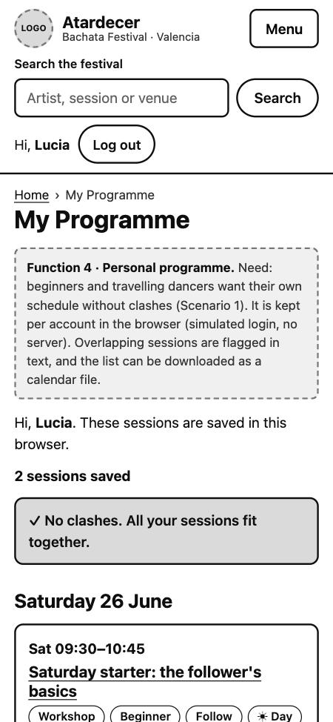
Scenario walkthrough
Scenario 1 · First-timer on a phone
Scenario 2 · Experienced dancer on desktop
1. Filter: Saturday, Workshop, Beginner, Follow
2. Save while logged out: sign up (demo)
3. Back on the list: first workshop is saved
4. Save the second workshop at 11:00
5. My Programme: 2 sessions, no clashes
1. Filter: Friday, Social, Night, Marea Club
2. Open the 22:00 session: DJ and time
3. Open the DJ page: all set times
Notes:
PRESENTER: Sebastian (about 60 seconds).
Say: both key scenarios can be completed in the prototype. Scenario 1: a first-timer on a phone filters Saturday beginner follower workshops, presses Save, is asked to sign up (a demo account kept in the browser), returns, saves a second workshop and sees both in My Programme with no clashes. Scenario 2: on desktop, filter Friday night socials at the club, open the 22:00 session, then the DJ page for set times. Offer to show it live from the Prototype guide page.

Slide 5
How we used AI and checked it
12
2 of 2
0
problems found and fixed by running and measuring
key scenarios completed, also on the live site
network requests in the prototype
What AI did
Planned the screens, wrote the HTML, CSS and JavaScript, wrote the design kit and ran the browser tests.
What we decided
Grayscale mid-fidelity, the two key scenarios, the palette and fonts, and the avatars.
How we checked
Ran both scenarios in a real browser, locally and live, and measured contrast, spacing and type on every page. A lost saved session after sign-up showed up only by running it.
Limits
Double-click opening tested in Chrome only. Not tested: Safari, Firefox, screen readers, real users.
Notes:
PRESENTER: Faiaz (about 55 seconds).
Say: AI wrote the code, but we checked it by running both scenarios. That found twelve real problems, for example the first saved workshop was lost after sign-up, and measuring the CSS found uneven spacing, too many font sizes and over-long text lines. We checked headings, labels, overflow, touch sizes and contrast on every page. We opened the prototype by double-click in Chrome only, and have not tested with real users.

